Slide 1
Data collection and transformation
Introductory Data Science for Innovation (995N1)
Week 4
David Eggleton, Yongyuan HUANG
With thanks to:
Frédérique Bone

Slide 2
Lecture objectives
Bases of data science:
This lecture will present you with an overview of data sources which are relevant for innovation studies. A few of these sources will be explored in depth in the next two lectures.
Secondly the lecture also aims to give a brief introduction of the format the data can take. How to treat these will be explored further in the seminars.
Finally, this lecture will give you a broad overview of good practice when using data collected from the web.

Slide 3
Agenda and Learning objectives
Looking at where we can get secondary datasets
Trying to put together our own datasets from non-traditional places
What are the pros or cons of such approaches?
What are the ethics of our various approaches?
Know about the variety of data sources which can be used to study science and innovation
Understand how hard/easy it is to extract data from these data sources (both theoretically and practically)
Explain considerations for the use of this data (data bias)
Understand and consider ethical considerations for data collection and use

Slide 4
Range of data on innovation

Slide 5
Finding data – existing databases
The usual suspects:
Existing databases
Data available in through API
Data you retrieve directly from digital sources (webpages)
Notes:
There are many usual suspects for

Slide 6

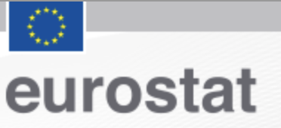







Finding data – existing databases
Existing databases
Data available in through API
Data you retrieve directly from digital sources (e.g. webpages, documents…)
The usual suspects:
You may need to pay for access, or an institutional subscription.
Notes:
Eurostat for CIS survey
OECD – variety of macro-economics statistics across countries
These may represent organisations, (companies and university), science/knowledge, which may be needed for technology, patents which represent technology, or others- such as human capital…

Slide 7

Notes:
Now it is easier than ever to build a flashlight.

Slide 8
There may be another light over there…
Notes:
Now it is easier than ever to build a flashlight.

Slide 9










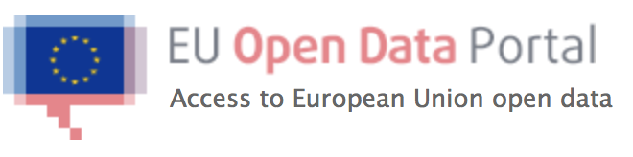
Finding data – existing databases
Existing databases
Data available in through API
Data you retrieve directly from digital sources (e.g. webpages, documents…)
But other structured datasets can be used:
Notes:
There are many usual suspects for
The PhD students databases
Other EU Data
The acceptance survey (AMR)
Make the point that these organisations actually want the data to be used (make it freely available and please use it!)
Or even smaller datasets: welcome trust funding grants

Slide 10
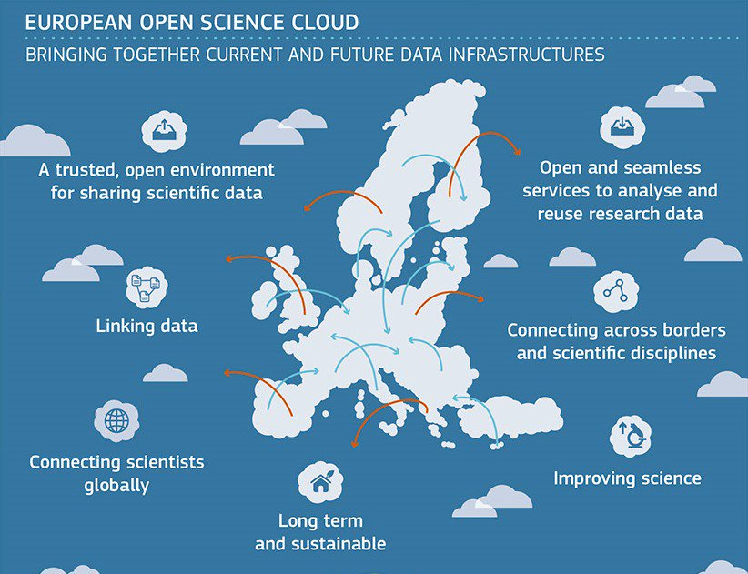
Finding data – existing databases
Existing databases
Data available in through API
Data you retrieve directly from digital sources (e.g. webpages, documents…)
But other structured datasets can be used:
Notes:
There are many usual suspects for
The PhD students databases
Other EU Data
The acceptance survey (AMR)
Make the point that these organisations actually want the data to be used (make it freely available and please use it!)
Or even smaller datasets: welcome trust funding grants

Slide 11

You can explore beyond here…
Notes:
Now it is easier than ever to build a flashlight.
There is a world to explore beyond the usual structured dataset (beyond the lamppost)

Slide 12
Finding data – through APIs
Existing databases
Data available through APIs
Data you retrieve directly from digital sources (webpages)

Slide 13
Finding data – through APIs
Available databases
Data available through APIs
Data you retrieve directly from digital sources (e.g. webpages, documents…)
API (web application - Application Programme Interface)
Ask for a subset of data to a website (in an automated way)
The request is done through the URL
<base-url> + <information about request>
The website returns a webpage with some structured text
You usually copy the content from the webpage
It is easily parsed due to its structure (XML, Json format)
You could do that directly through a browser, or even using programming tools (without opening a browser).

Slide 14











Finding data – through APIs
Available databases
Data available through APIs
Data you retrieve directly from digital sources (e.g. webpages, documents…)
Easier to access a subset of the data (some databases are very large)
Access to complementary information
Notes:
You can use these to build a primary dataset
Or you can use it to complete your data - there are more and more structured identifiers in order to be able to link the data between databases.

Slide 15


Finding data – through APIs
Available databases
Data available through APIs
Data you retrieve directly from digital sources (e.g. webpages, documents…)
Easier to access a subset of the data (some databases are very large)
Access to complementary information
Notes:
You can use these to build a primary dataset
Or you can use it to complete your data - there are more and more structured identifiers in order to be able to link the data between databases.

Slide 16
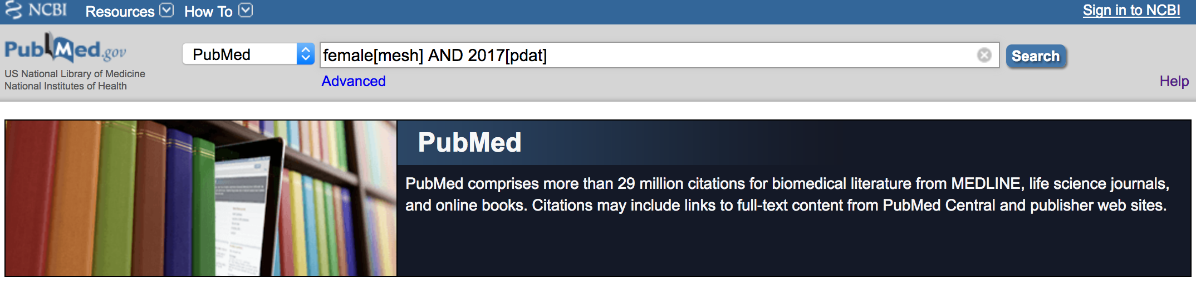
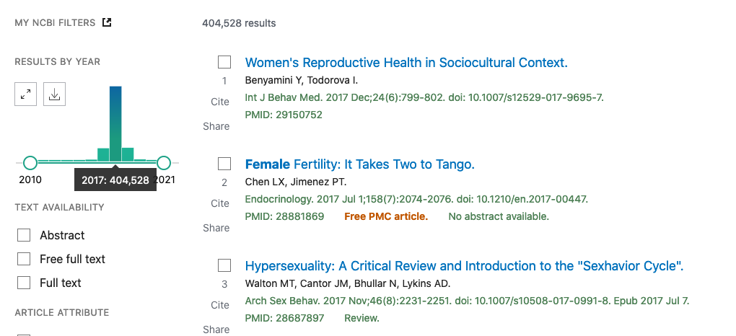
Finding data – through APIs
Available databases
Data available through APIs
Data you retrieve directly from digital sources (e.g. webpages, documents…)
Example from PubMed:
I want to find out how many publications there are when searching for a specific Meshterm “female” in the year 2017.
Notes:
https://www.ncbi.nlm.nih.gov/pubmed
female[mesh] AND 2017[pdat]
Documentation https://www.ncbi.nlm.nih.gov/books/NBK25497/

Slide 17
Finding data – through APIs
Available databases
Data available through APIs
Data you retrieve directly from digital sources (e.g. webpages, documents…)
Example from PubMed:
I want to find out how many publications there are when searching for a specific Meshterm “female” in the year 2017.
<base-url>+<information about request>
URL:
Base: https://eutils.ncbi.nlm.nih.gov/entrez/eutils/esearch.fcgi?
Database: db=pubmed
Search: term=female[mesh]+AND+2017[pdat]
https://eutils.ncbi.nlm.nih.gov/entrez/eutils/esearch.fcgi?db=pubmed&term=female[mesh]+AND+2017[pdat]
Notes:
Documentation https://www.ncbi.nlm.nih.gov/books/NBK25497/

Slide 18
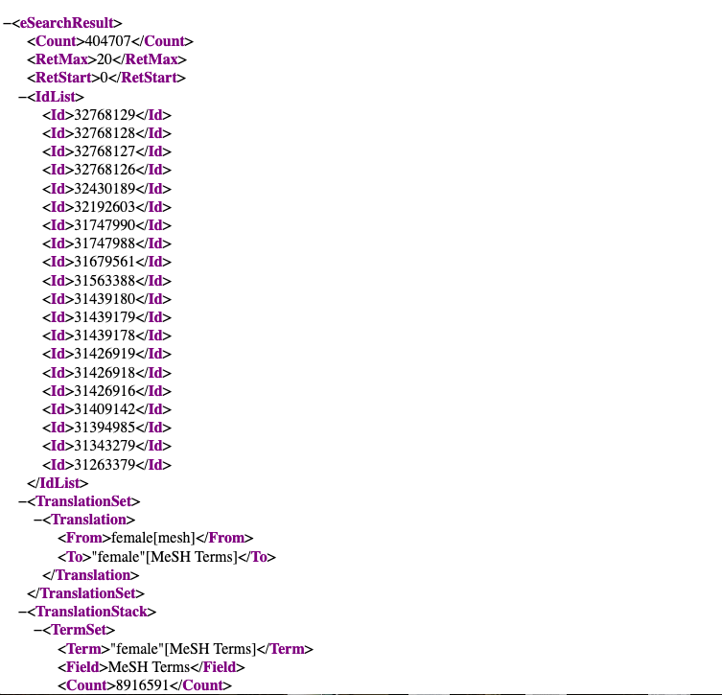

Slide 19
Finding data – through APIs
Available databases
Data available through APIs
Data you retrieve directly from digital sources (e.g. webpages, documents…)
Second example from OpenAlex:
Docs: https://docs.openalex.org/
OpenAlex is really nice because if you really want you you can download a database snapshot and upload it to your own server and apply customisations (a la CWTS). Makes your life easier as you shall see!
Notes:
Documentation https://www.ncbi.nlm.nih.gov/books/NBK25497/

Slide 20
Finding data
Available databases
Data available through APIs
Data you retrieve directly from digital sources (e.g. webpages, documents…)

Slide 21
Finding data
Data you retrieve directly from digital sources (e.g. webpages, documents…)
Any webpage is a structured document,
and you can extract data from it.
Let’s say I want to study spin-offs from the University of Sussex:
Start by looking at the incubator website:
https://www.sinc.co.uk/
Look for companies list
Can I export the list?
Developer tab (see the web page in a raw format)
Use of URL to iterate over the pages (use of loops)
Notes:
</h[1-3]>[[:print:][:space:]]*?<h[1-3]>
(</h1>|</h2>|</h3>|</p>)[[:space:][:print:]]*?(<h1>|<h2>|<h3>|<p[[:space:][:print:]]*?>)
Wayback machine
Structure of website – getting company names
sussex innovation center: </h2>[[:print:][:space:]]*?<h2 itemprop="name">
2) Some tools to collect the data – regex, developer tab, looking at the
more advanced techniques
webscraping techniques

Slide 22
Good practice: Using data for research

Slide 23
How good is the data I get?

Slide 24
Data - quality
Every dataset has a context and history which defines its content
Different purposes
Different coverage (time / country)
The dataset may have evolved depending on user needs
Fields are introduced over time (e.g. acknowledgement /funding fields in bibliometric databases)
Some categorisation evolves over time and can create data inconsistencies (see NYT)
Notes:
Evolution may provide inconsistencies in the data, not all fields may be available for all periods.

Slide 25
Data - quality
Example from Web of Science data:
Bias of representation of languages (Chavarro, 2016)
Bias of representation of disciplines (Ciarli & Rafols 2017)
Coverage limitation for funding data (Grassano et al. 2017)
Example from the SPRU History project:
I built a database of SPRU staff to understand the scientific output over time.
Selection criteria of research staff
A colleague who wanted to re-use the data questioned its completeness.
Notes:
Garbage in – Garbage out.

Slide 26
Data - quality
Existing databases
Data available through API
Data you retrieve directly from digital sources (e.g. webpages, documents…)
Increasing cleaning needed
The more bespoke your data, the more you will need to spend time on data cleaning…
Notes:
May require quite a btit of trial and error

Slide 27
No dataset is objective.

Slide 28
No dataset is objective. They have a context and history.

Slide 29
Data - quality
Every dataset has a context and history which define its content
Different purposes
Different coverage (time / country)
The dataset may have evolved depending on user needs
🡪 How do I choose the right data for my analysis?
Notes:
May require quite a btit of trial and error

Slide 30
Get the right data
Research question
Start with your research question:
Object of study / phenomena
What aspects / properties are important?
Is there an existing dataset that captures these:
Is it a good representation of the phenomena
Does it cover well the aspects which are important.
How well does the data capture my research design?
Is there other data that I can use?
Is there complementary data?
Should I adapt my research question?
object of study / phenomena
Properties /aspects
Adapt research question or data?
Database / dataset
Variables
Related variables /characteristics
Missing aspects
Notes:
Garbage in – Garbage out.

Slide 31
Get the right data
Research question
object of study / phenomena
Properties /aspects
Trade-off:
Fit of the proxy to the object of study
Feasibility/time:
Searching for appropriate data
Cleaning, prepare the data for analysis
Conduct the appropriate analysis
Adapt research question or data?
Database / dataset
Variables
Related variables /characteristics
Missing aspects
Notes:
Garbage in – Garbage out.

Slide 32
Data - quality
Usual concerns about getting data for your study:
Is the database clean enough for moving to the analysis
Does it include all the variables to do my ‘fancy’ analysis
Is the database large enough for me to do a large scale/ comparative analysis
Concerns you should have when choosing data:
Is the database complete enough to generate sufficient insights for my analysis?
🡪 Meaning of the absence of data: non-existence vs. not captured
Is the proxy I use good enough to represent what I want to study?
Notes:
May require quite a btit of trial and error
A dataset has boundaries and is collected for a reason – the data may be extended over time because users ask for things
Presence of data (the thing that is under the light – we now that it exists and we are able to observe it)
The absence of data: (two explanations)
There is nothing there – this is why we cannot observe it
There is something there but it is just not represented in the dataset : why? How does this affect my study? Will it have a big impact on my results?

Slide 33
No dataset is bad per se,
they vary in quality and coverage.
Do they fit your research question?

Slide 34
General considerations when using resources you collect online…

Slide 35
Online data
Can we use any data available online?
Considering personal data with GDPR
Considering the burden on the data providers
Web scraping and research exemption
Always check the documentation on the website you wish to take data from
For research exemption: in doubt ask the library for guidance.
Notes:
May require quite a btit of trial and error

Slide 36
Personal data and GDPR

Slide 37
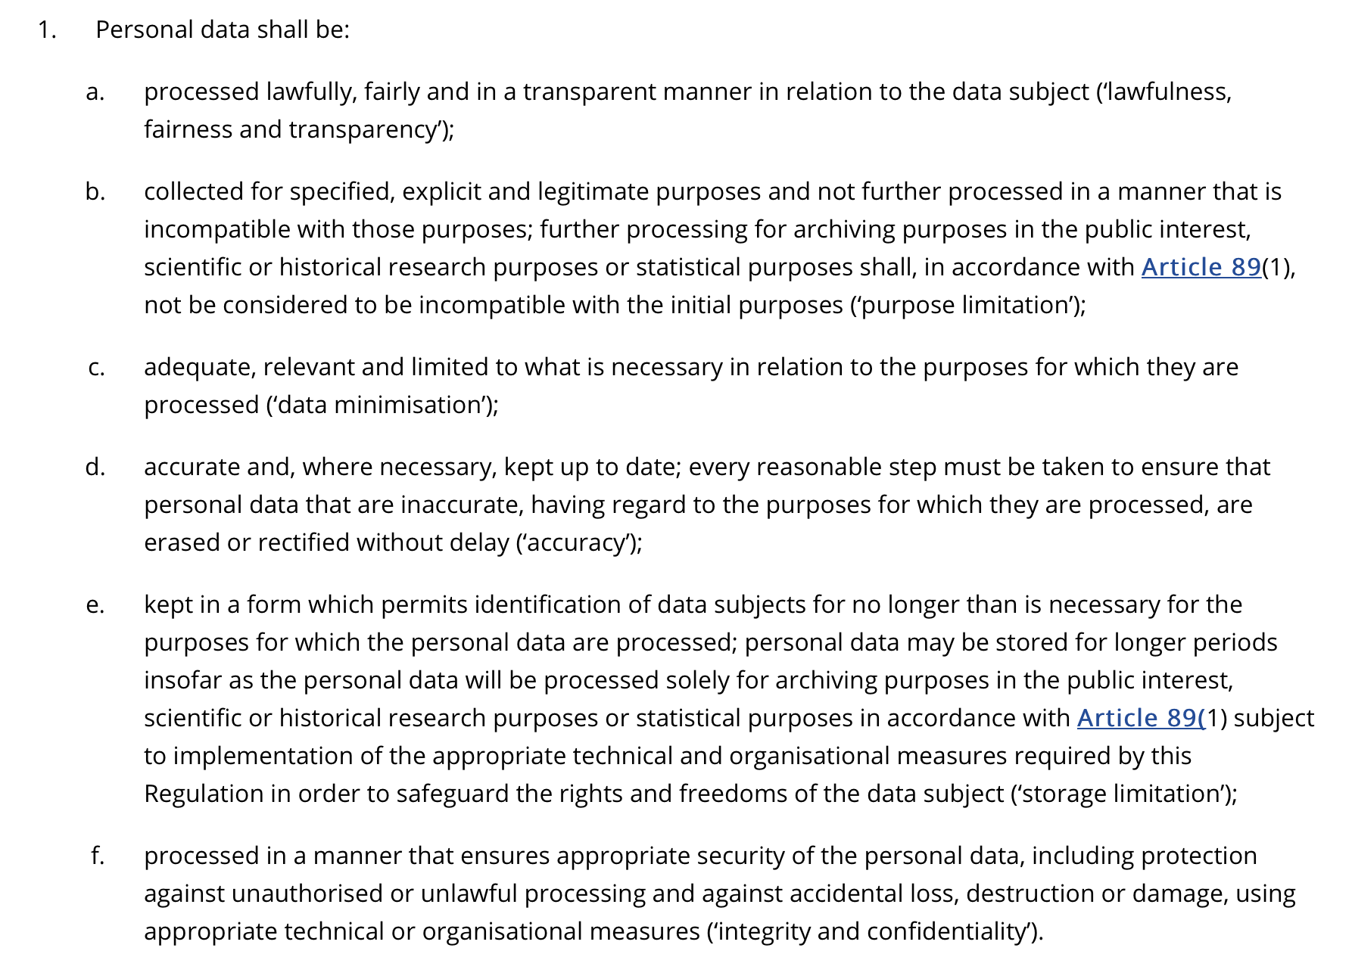
Considerations for web resources
https://gdpr.eu/article-5-how-to-process-personal-data/

Slide 38
Considerations for web resources
https://gdpr.eu/article-5-how-to-process-personal-data/

Slide 39
Website providing data to you bear a cost to send you data.

Slide 40
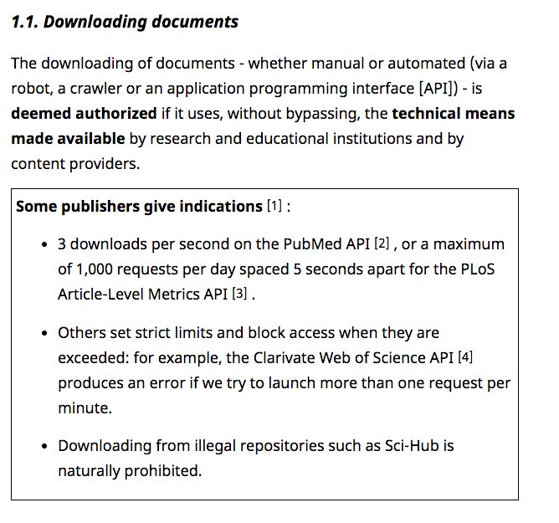
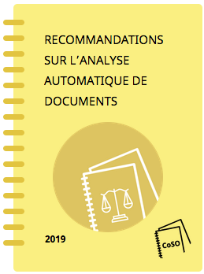
Data - considerations
Notes:
May require quite a btit of trial and error

Slide 41
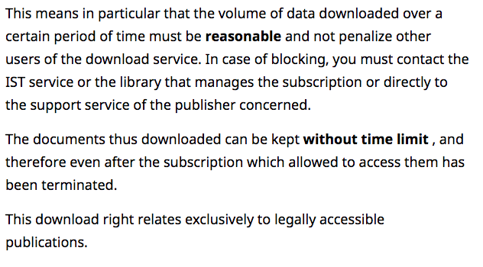
Data - considerations
Notes:
May require quite a btit of trial and error

Slide 42
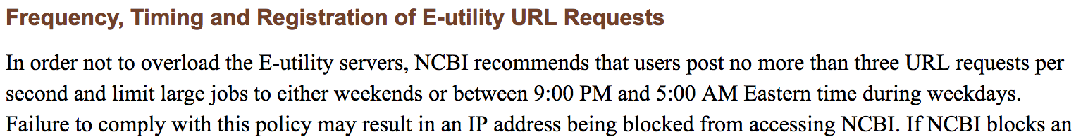
Documentation on TDM
Burden of requesting data from a website
(both for APIs and web scraping)
There is only so much traffic a website can handle.
Notes:
May require quite a btit of trial and error

Slide 43

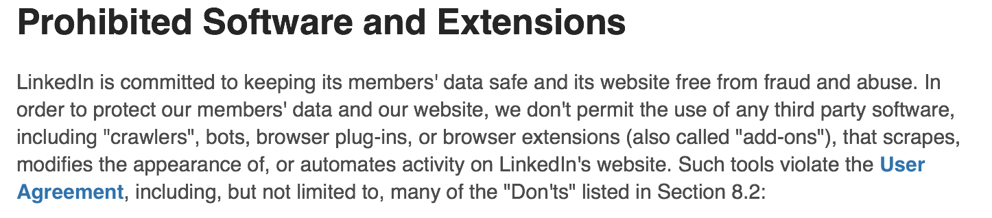
Data - considerations
Burden of requesting data from a website
(both for APIs and web scraping)
There is only so much traffic a website can handle.
Ethical concern on the data you collect:
All data publicly available online can not always be freely used.
If in doubt, ask your library services…
Notes:
May require quite a btit of trial and error

Slide 44
Text and data mining: Research exemption…

Slide 45
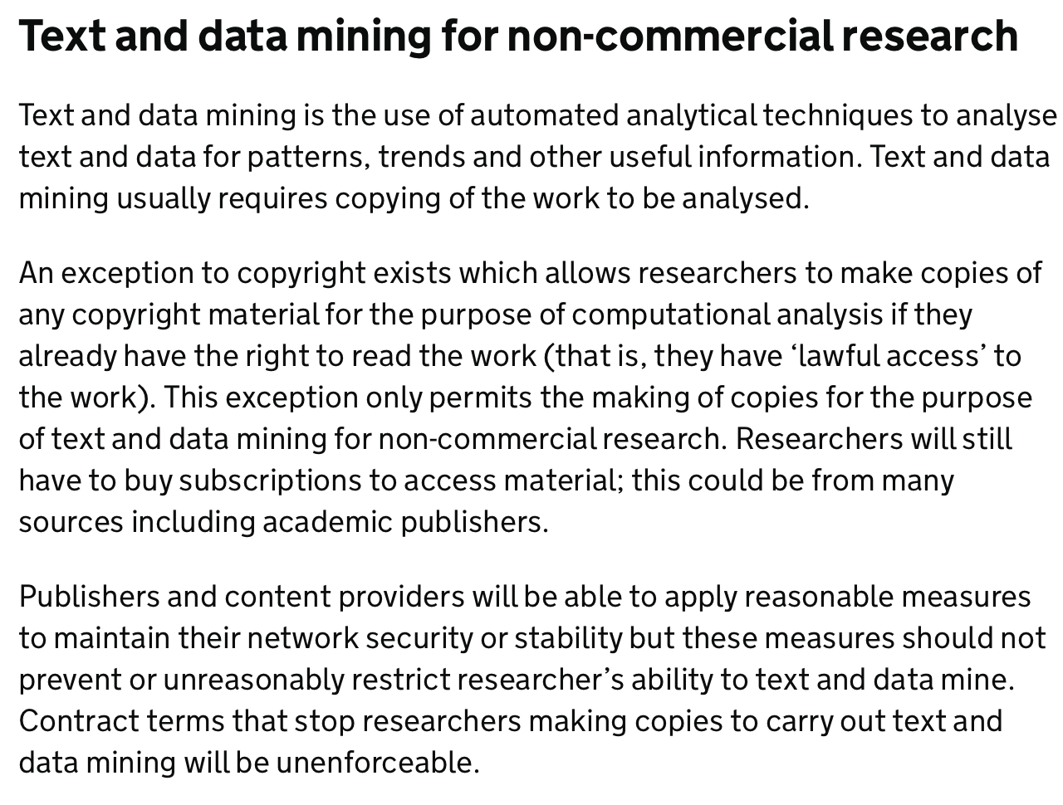
Text and Data mining (TDM)
https://www.gov.uk/guidance/exceptions-to-copyright#text-and-data-mining-for-non-commercial-research

Slide 46
Text and Data mining (TDM)
Copying and using copyrighted text is not allowed in general:
There is a research exception to this (if the data is use for research purposes)
This may differ by country (this is specific for research in the UK)
Due to copyright issues, this won’t be the case if you work for a commercial organisation
You still have to be careful of the considerations above
Some publishers may not welcome this even for research purposes.
🡪 In doubt, ask the library (for university projects) or contact the relevant copyright holder to find a suitable arrangements (for your future work in private sector)

Slide 47
Let’s Practice!

Slide 48

Let’s start!
Load the Script of this week:
W4-webdata_exercise_SIC.Rmd
We are going to build a dataset from the previous website to build a incubator start-up dataset using Rvest

Slide 49

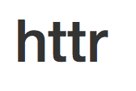
In which form will I get the data?

Slide 50
Data Format
Tables - two dimensional data:
Excel spreadsheet (multiple sheets in a file)
.csv files which are usually comma delimited
but can also have other types of delimiters (tabs generally).
Proprietary formats .sav (SPSS), .dta (Stata)

Slide 51
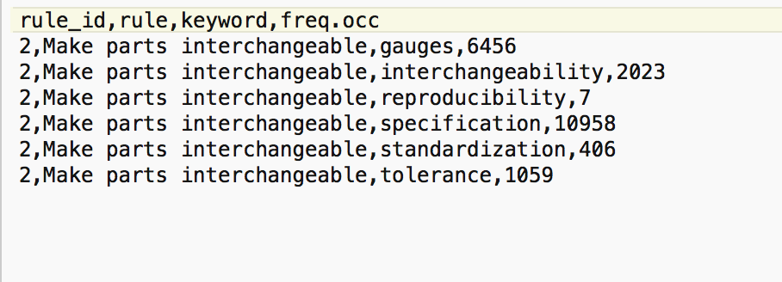
Data Format
Example of a csv file:

Slide 52
Data Format
Nested /Hierarchical data:
.json
XML files which are usually comma delimited
Data gathered through APIs are usually coming in this format.
Notes:
https://api.altmetric.com/v1/citations/1d

Slide 53
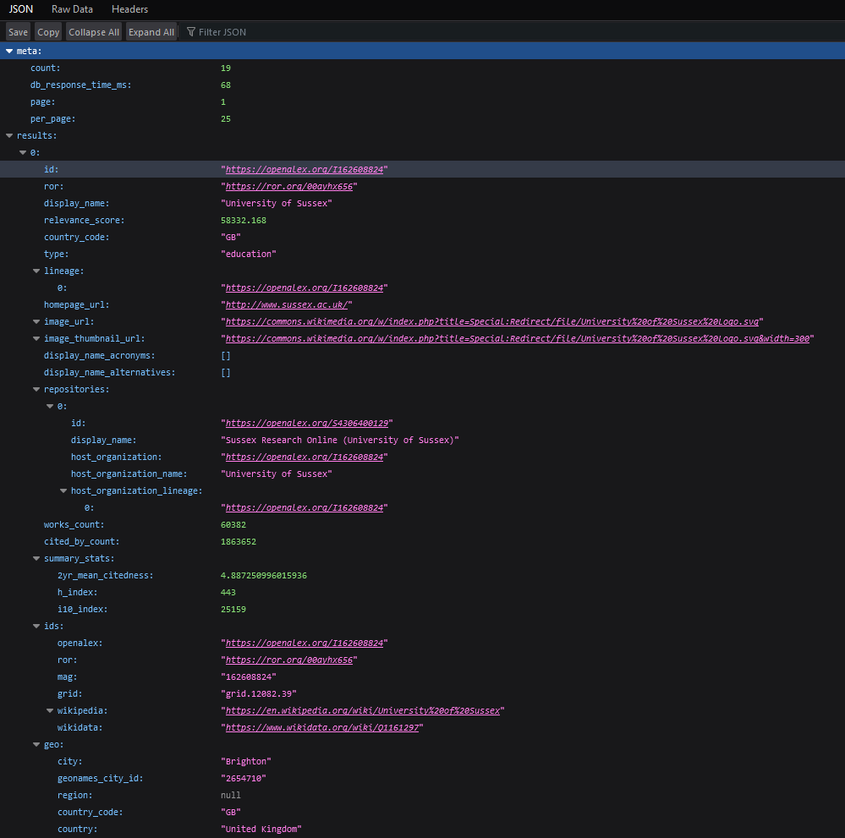
OpenAlex API through browser)
https://api.openalex.org/institutions?search=sussex

Slide 54
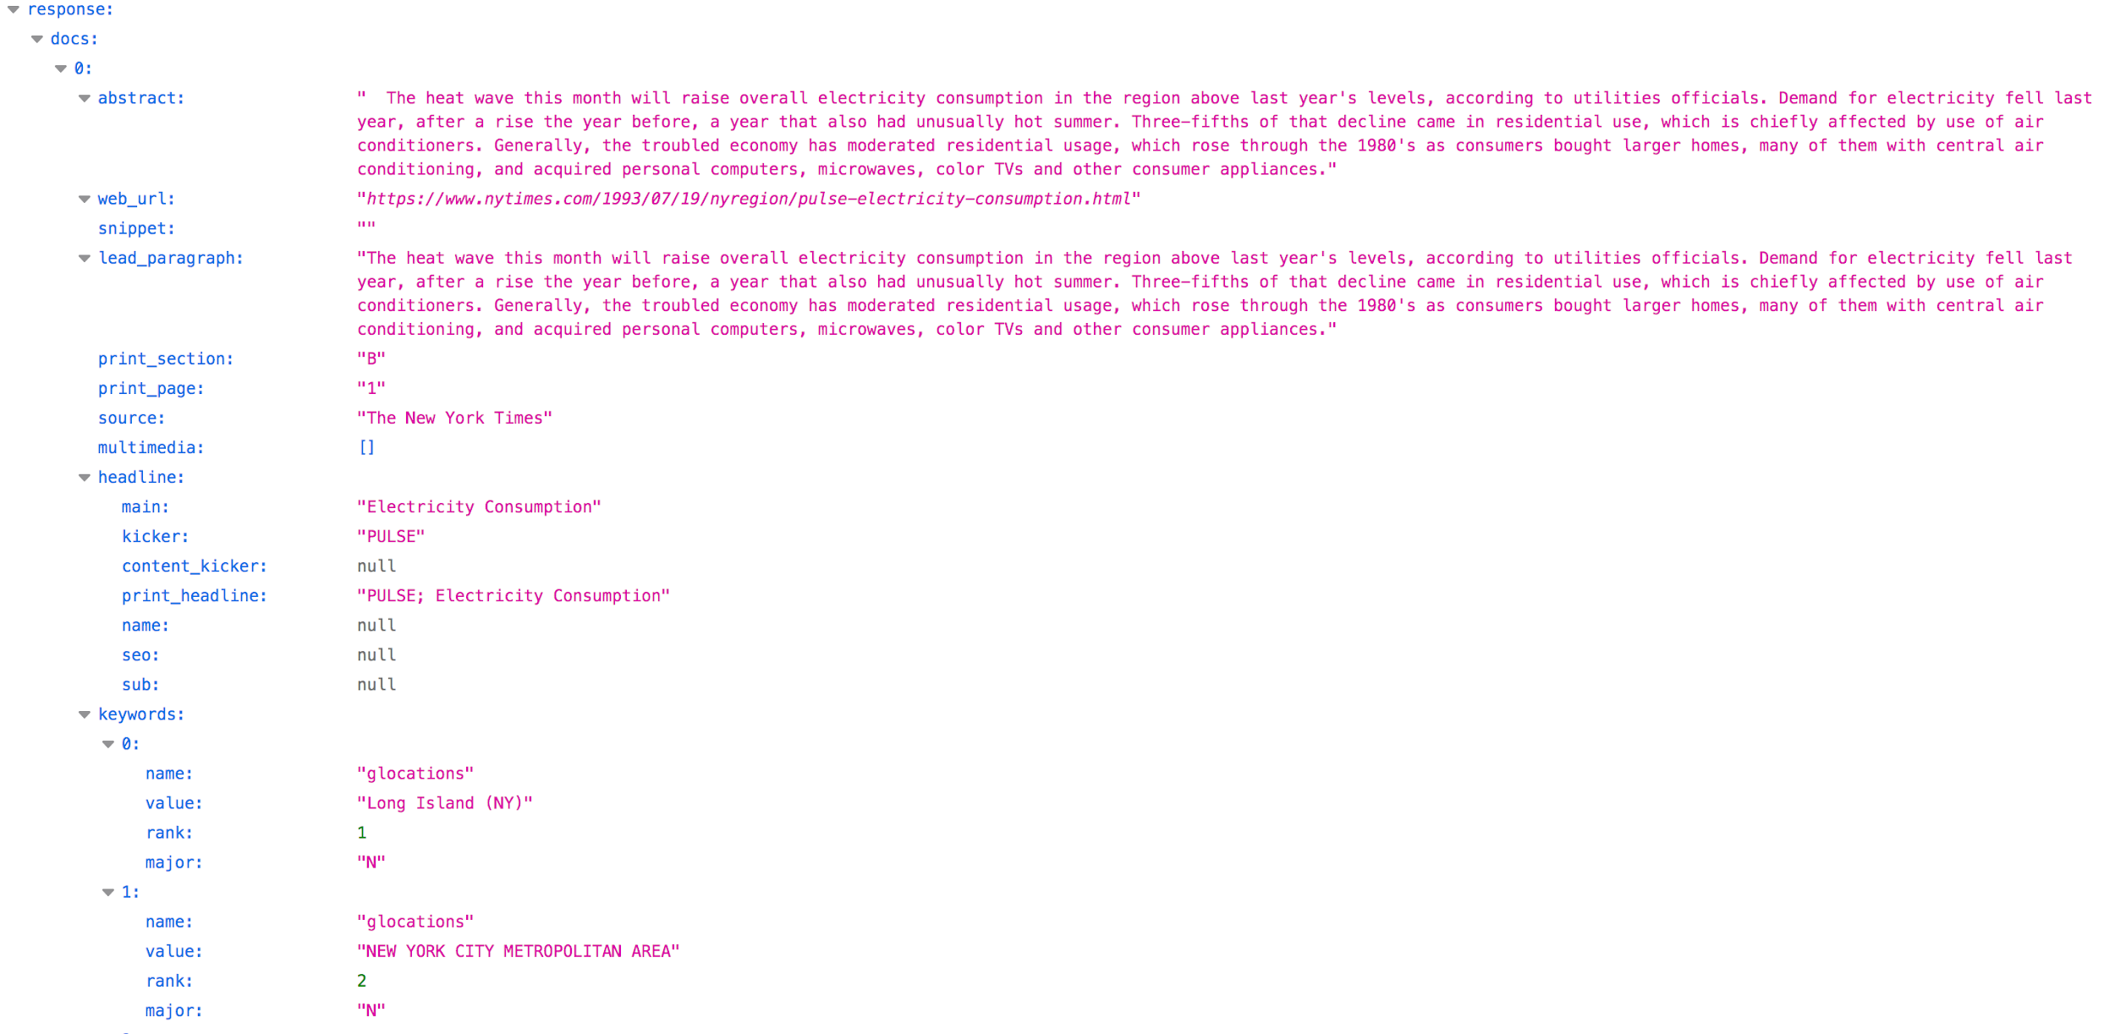
NYT API
Abstract | Web_url | … | headline |  |  | Keywords
 |  |  | main | kicker | … | name | value | rank | major
Notes:
https://api.nytimes.com/svc/search/v2/articlesearch.json?q=electricity&api-key=8o0rq1Z78Su8bbfgDwLWfDDoRnJejhXX

Slide 55
Data Format
Nested /Hierarchical data:
.json
XML files which are usually comma delimited
Data gathered through APIs are usually coming in this format.
Difficulty in dealing with lists within lists
You may need to specify how to import the data in a data frame format
Notes:
https://api.altmetric.com/v1/citations/1d

Slide 56
Data Format
Free text format (with or without metadata)
Web pages
Scanned Text
Other .txt outputs
You have to explore the underlying structure to find the best way to parse the data.

Slide 57
Agenda and Learning objectives
Looking at where we can get secondary datasets
Trying to put together our own datasets from non-traditional places
What are the pros or cons of such approaches?
What are the ethics of our various approaches?
Know about the variety of data sources which can be used to study science and innovation
Understand how hard/easy it is to extract data from these data sources (both theoretically and practically)
Explain considerations for the use of this data (data bias)
Understand and consider ethical considerations for data collection and use

Slide 58
Data - considerations
https://www.europarl.europa.eu/RegData/etudes/BRIE/2018/604942/IPOL_BRI(2018)604942_EN.pdf
https://www.communia-association.org/2017/12/01/uk-government-report-right-read-right-mine/
https://www.jisc.ac.uk/guides/text-and-data-mining-copyright-exception
https://assets.publishing.service.gov.uk/government/uploads/system/uploads/attachment_data/file/375954/Research.pdf
https://www.ouvrirlascience.fr/recommandations-sur-lanalyse-automatique-de-documents-acquisition-gestion-exploration/
Notes:
May require quite a btit of trial and error

Slide 59
Thank you. Contact:
David Eggleton
(d.eggleton@sussex.ac.uk)

